Slide 1
Final Exam Review

Slide 2
Rules for Writing the Exam
Open book
3 multiple choice, 2 long answer
To get full credit on a question
No copied questions from existing exams
Must be on material taught in class or in a reading
Must write question and answer
Answer must be correct
Answer length must conform to our requirements

Slide 3
Exam timeline
You can start writing questions as soon as class ends
Written answers are due by 10:00am on Thursday
Peer grades are due by midnight on Friday

Slide 4
What makes a good question?
It is clear
It stays on topic (doesn’t bring material from outside the class in)
It is not ambiguous (multiple interpretations or correct answers)
It is not obscure
More than ¼ of the class could answer it in the time allotted
It requires some thought to answer

Slide 5
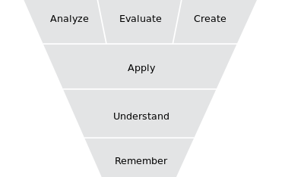
Bloom’s Taxonomy
Notes:
Helps to describe what makes questions difficult!

Slide 6
Grading Criteria
This question is clear and unambiguous (3)

Slide 7
Grading Criteria
This question is clear and unambiguous (3)
3 points: Good to excellent in this regard
2 points: Question (or answer) has small problems
1 points: Question (or answer) has significant issues
0 points: Question or answer is missing

Slide 8
Grading Criteria
This question is clear and unambiguous (3)
Right level of difficulty (not too obscure, etc.) (3)
3 points: Good to excellent in this regard
2 points: Question (or answer) has small problems
1 points: Question (or answer) has significant issues
0 points: Question or answer is missing

Slide 9
Grading Criteria
The question is clear and unambiguous (3)
Right level of difficulty (not too obscure, etc.) (3)
The answer given is correct (5)
Will be checked by Nikola and I

Slide 10
Grading Criteria
The question is clear and unambiguous (3)
Right level of difficulty (not too obscure, etc.) (3)
The answer given is correct (5)
The question is interesting/good (1)

Slide 11
Grading Criteria (15 total per question, only 14 peer graded for long answer)
The question is clear and unambiguous (3)
Right level of difficulty (not too obscure, etc.) (3)
The answer given is correct (5)
The question is interesting/good (1)
All the short answers are explained (2)
All three short answer questions differ from each other (3)
Long answers are on varied topics (1) (Nikola & I will check)

Slide 12
Grading criteria for your peer grading
Good written feedback on ALL questions (meaningful comments/suggestions)
Clearly explain reasons for sub-scores below 3
Correctly decide whether question answer is correct
You may post questions on Piazza (anonymously) to discuss the answers and reach consensus about what is correct.

Slide 13
Examples of things that result in low scores on final
0: Copying text from the internet
0: Copying text from my slides
Very short explanations
Incorrect answers
Only one multiple choice answer option
Only explaining one of the multiple choice answer options

Slide 14
What I consider to be key material from the class
Will review that now to help focus you and answer any questions

Slide 15
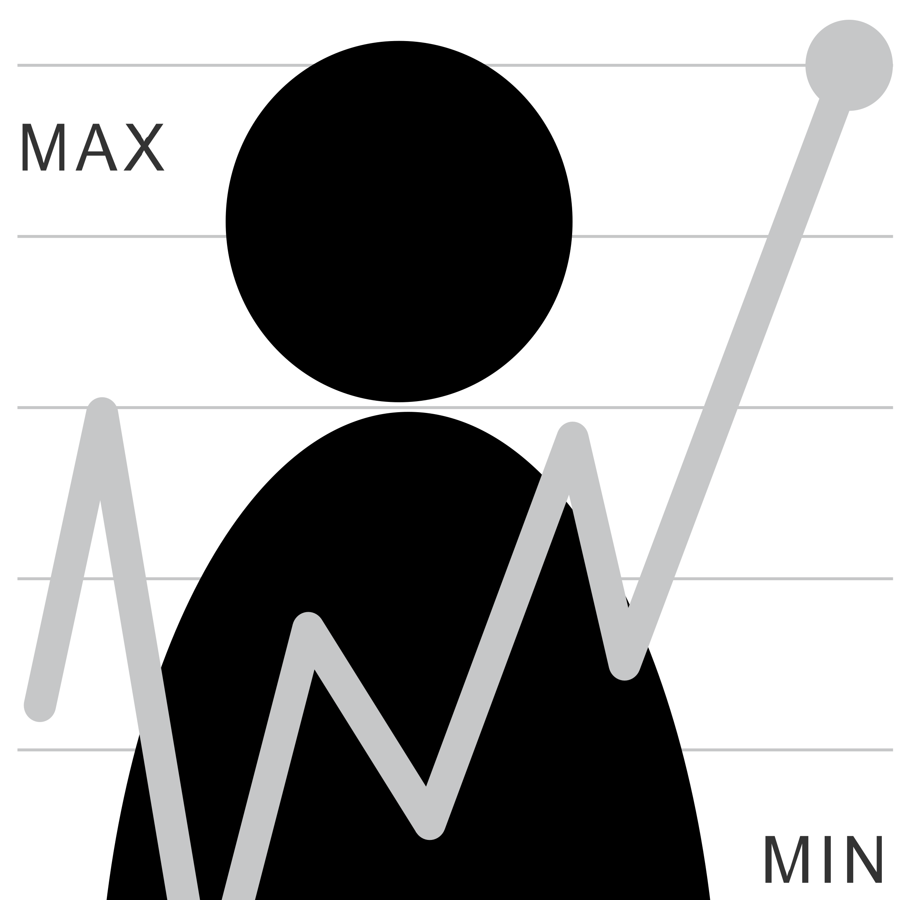
Where are end users (and HCI) implicated?
Question
Is it the right question?
Collect Data
Is it the right data for the question?
How hard/easy is it to collect?
Clean Data
What flaws exist in the data?
How do we address them?
Is it answerable?
Explore Data
Intuition
Use data
Communicate/Predict/…
Stats/Graphs/ML
Report on Findings
Visualize

Slide 16
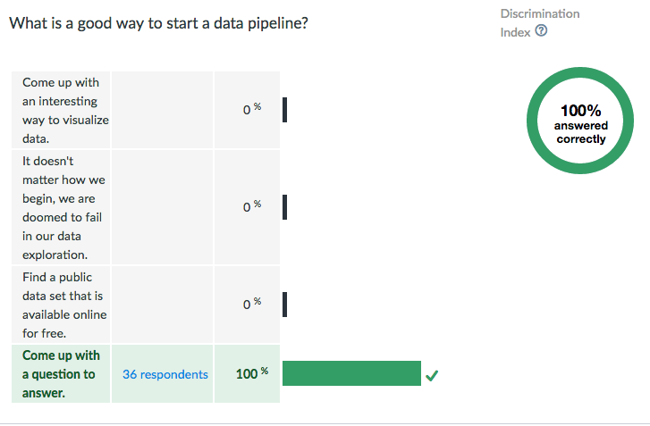

Slide 17
Two ways to store data
Data spread over multiple structures that reference each other [Database]
All data in a single structure [JSON; XML; API calls (even over a database)]
Data may include multiple types such as strings and numbers [Both]
Notes:
Many said single structure for database
I would say that’s not true in a typical production database today

Slide 18
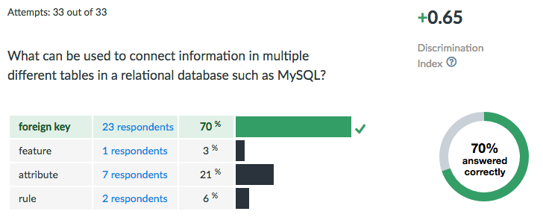

Slide 19
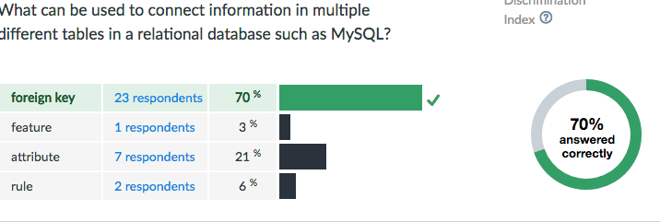

Slide 20
Data Storage
Data Management is a people problem
Who should oversee it?
Requires lots of attention, over time, regular checks, etc.
Who is responsible for the four Cs? (Completeness, Coherence, Correctness, AcCountability)
Types of data
Unstructured/semistructured/structured

Slide 21
What is a Data Model?
What data is stored and how it is organized
Key benefits:
Leverage (big impact on programming; cost; etc.)
Conciseness (implies an interaction model)
Can encode integrity constraints
Know what makes a good data model (concise, stable & flexible, quick, elegant…)
Notes:
For programs:

Slide 22
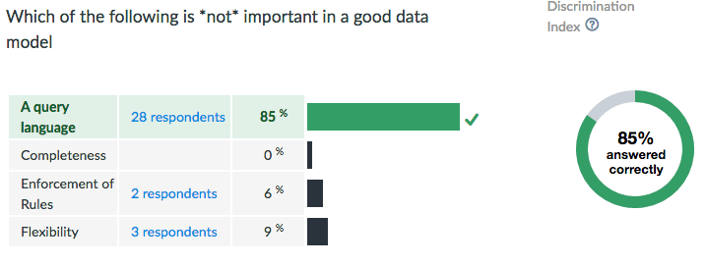

Slide 23
Four C’s of Data Quality
Is your data Complete?
Match the question/None missing/None wrong
Is your data Coherent?
Makes sense relative to itself (frequency, values, distribution, outliers, skew …)
Is your data Correct?
Makes sense relative to the world
Not fraudulent/erroneous/badly designed or administered survey/sensor
Is your data aCcountable?
Provenance and documentation
Notes:
First reason to

Slide 24
Some specific techniques to keep in mind
How to detect and quantify errors?
Glitch signature
Summary statistics
Graphs and Charts
Specific things to look for
Outlier detection techniques
Skew
Techniques for fixing
Imputation
Winsorization
De-Duplication
Domain specific approaches
Notes:
Winsorization: limit outliers (extreme values) to e.g. 90%

Slide 25
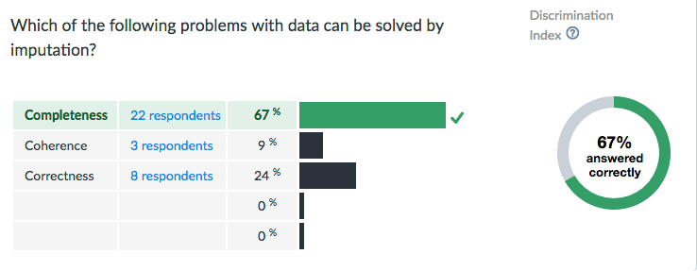

Slide 26
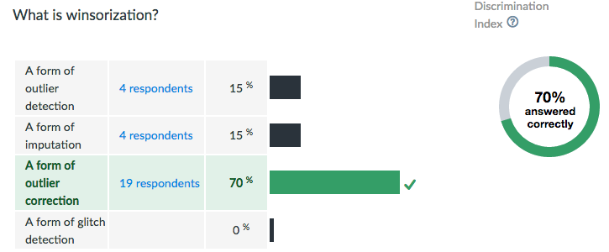

Slide 27
Acquiring Data
Data sampling issues
Understand terms: Population, Sample, Random Sampling Error, Bias
Understand what makes a good sample
Understand types of Bias
Systematic Bias, Selection Bias, Non-response Bias
Understand how changing population size affects different types of error [larger sample decreases random sampling error; dosen’t affect Bias]

Slide 28
Goals of Exploratory Data Analysis
Summarizing the Data
Summary Tables
Descriptive statistics
Graphs
Identifying problems (such as outliers)
[eventually] Finding Hidden Relationships
Asking specific questions
Correlations
Grouping
[eventually] Making Predictions

Slide 29
What Type of Data Exist?
Constant (e.g., mouse gain)
Continuous Data: Ration/Interval (e.g., mouse location)
Discrete Data (often scales): Nominal/Ordinal
(e.g., slip/no slip on this interaction)
What are the units?
Notes:
Interval: Scales that describe values where the interval between the values has meaning. Temperature.
Ratio: Interval + clear definition of 0. Weight…

Slide 30
What Role?
Descriptor / Feature: predictive of labels (e.g. Click Duration)
Response / Label:
outcome of prediction
response to an intervention / question
(e.g. Diagnosis)
Notes:
Example scripts to address each of these?

Slide 31
Exploring your data
Transformations such as normalization, logs, and feature creation
Allows different fields to be compared
Avoids undue influence of a column that happens to have large values
Often moves data to 0-1 range
Non-linear transformations (e.g., transforming log-normal data to a normal scale by taking the log)
Notes:
----- Meeting Notes (4/23/15 09:54) -----
don't address feature creation here.

Slide 32
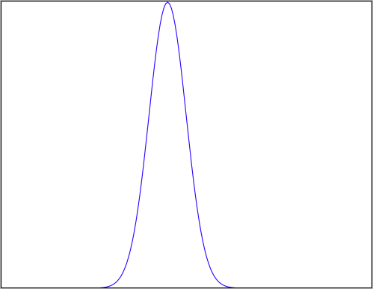
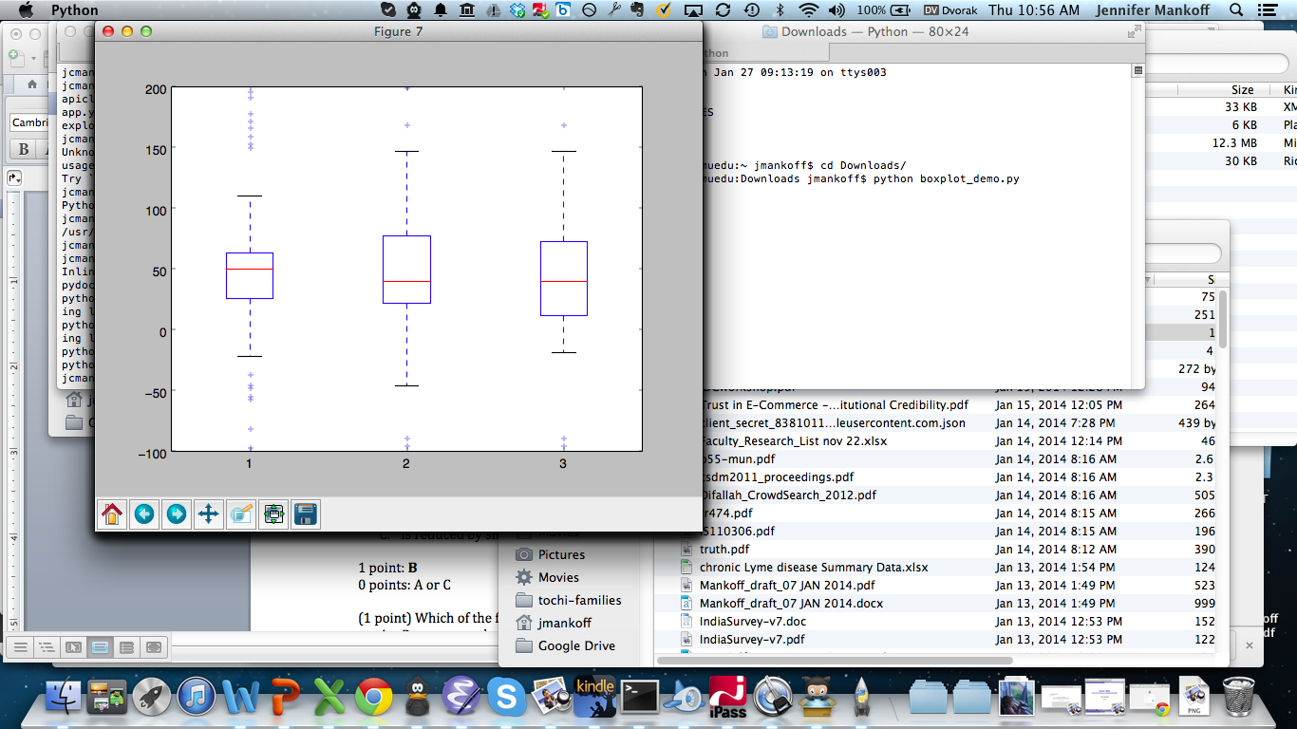
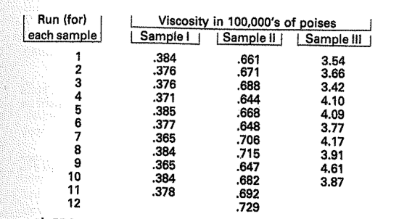
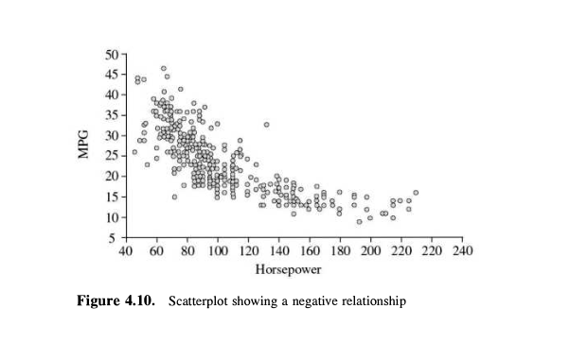
Exploring your data
Transformations such as normalization, logs, and feature creation
Plots and their value
Stem and leaf [flexible & quick]
Boxplot [comparison; some structure]
Histogram [check a distribution]
Scatterplot [show a relationship]

Slide 33
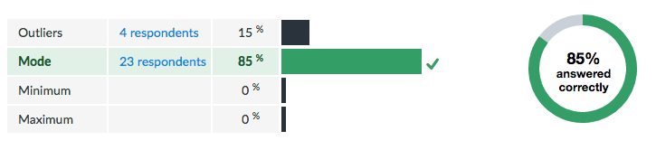

Slide 34
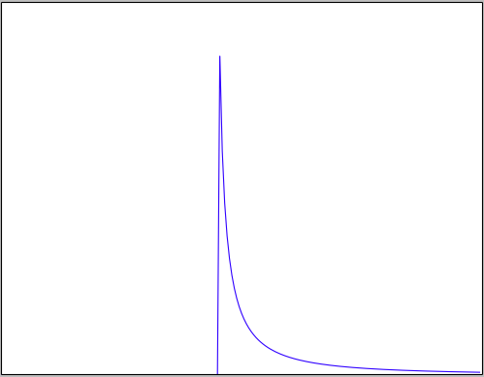
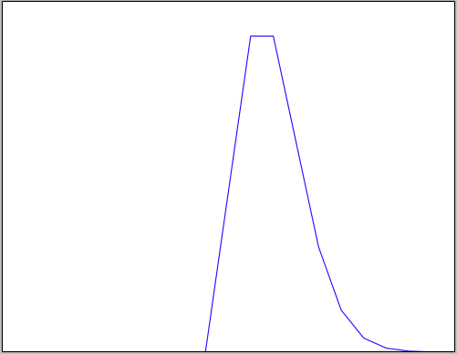
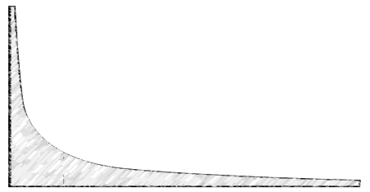
Exploring your data
Transformations such as normalization, logs, and feature creation
Plots and their value – stem & leaf; boxplot; histogram
Distributions and some of their assumptions
Normal: Independent, Identically distributed random variables
Log Normal: Multiplied independent random vars (intuitively: one end is fixed, e.g. timings all > 0)
Poission: Constant rate of independent events
Power Law: Events are not independent; Proportional to 1/k^{n}
Notes:
First reason to explore the data is to check its validity!

Slide 35
Notes:
I want you to contrast everything we said with this slide. This is from Giorgia Lupi, one of the authors of Dear Data.

Slide 36
Dealing with very large data
Typically distributed [may lead to partitions; maximize consistency or availability: CAP]
Types of data bases to consider
Key-value stores [fast collection, slower query]; e.g. Redis
Distributed, fast schemas [append only, good for exploratino]; e.g. Dremel, BigQuery
Need to consider data processing too
Map-reduce framework for parallelizing operations: batch work
Distributed queries & insertions (e.g. Hive)
Distributed ML (e.g. MAHOOT)

Slide 37
Tradeoffs in Choosing A Big Data Architecture
Cost (money & time): No support for estimating cost or duration
Data Guarantees: Some theoretical grounding
Type of work being done (reading, writing, computation, etc.)

Slide 38
Relating infrastructure solutions to the Data Pipeline
Collecting Data: Read/Write/Modify Heavy?
Organizing and Processing for future needs: Hadoop/Map Reduce related tools [flexible, not always efficient, not enterprise-ready]
Visualization: Google Big Query + Viz (e.g. Vega-lite, Tableau)
Summarization: Google Big Query
In the cloud
Network speed a limiting factor

Slide 39
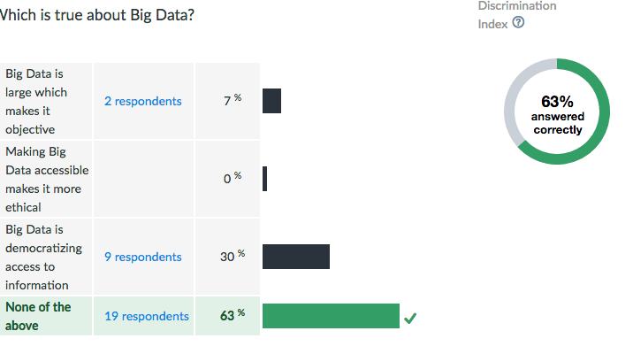

Slide 40
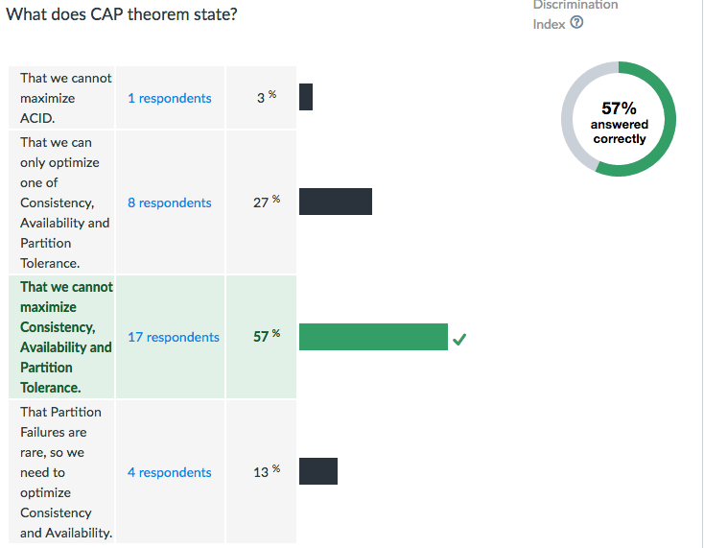

Slide 41
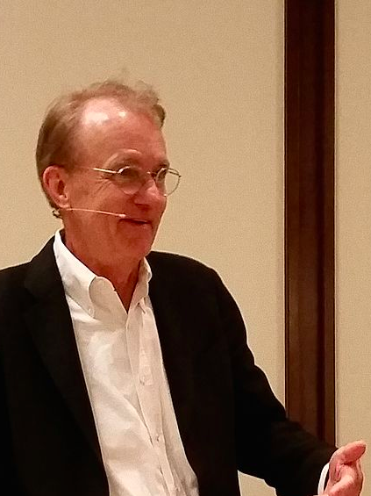
Planning a Visualization
What is its goal?
Does it support comparisons?
Causality, Mechanism, Structure, Explanation?
Multivariate analysis?
Integration of Evidence?
Documentation? [process & provenance]
Content (Most Important)
Don’t Lie!
Tufte (Yale)
Notes:
Avoid Ch

Slide 42
Narrative in Visualization
Documenting the question you are answering
Leading the viewer through a story
Another Example: http://projects.propublica.org/extinctions/

Slide 43
Narrative Tactics
Visual Structures (establishing shot, checklist, consistent visual platform)
Highlighting (color, motion, framing, size, audio, and more) – relates to last Tuesday’s perceptual characteristics
Transitions (McCloud; animation principals; etc)

Slide 44
Narrative framing choices
Obscuring
Leveraging Perceptual effects (from last Tuesday) to imply things whether or not correct
Using redundancy to emphasize
Using grouping
Contrast
…
Using Linguistic effects (irony, metaphor, etc)
Notes:
Democratic health plan…

Slide 45
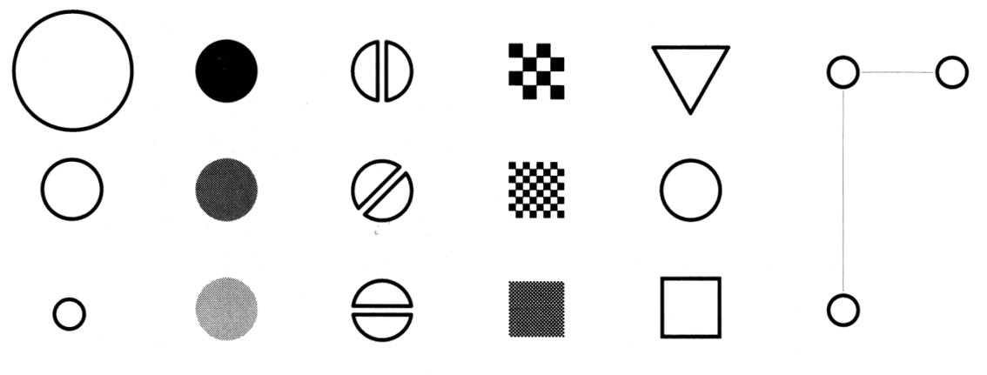
Making Things Distinct
Size
Value
Orientation
Texture
Shape
Position (2D / 3D)
Bertin’s ‘retinal variables’ form the basis for all forms of visual coding. A visual code can be based on (from left to right) contrasts of different types. Hue (chromatic color) provides an addition dimension not shown here.
Kevin Mullet and Darrell Sano, Designing Visual Interfaces
Slide from Marti Hearst/Jeff Heer via Jason Hong
Notes:
Note that while size and other cues provide for quantitative comparison, color (even luminance) only provides for ordering.
If the goal is contrast along any of these axes, make it distinct!

Slide 46
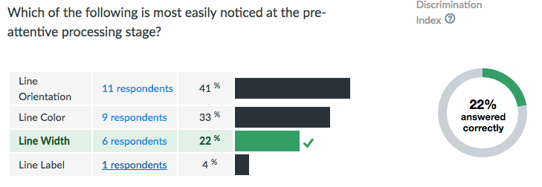

Slide 47
Pattern Perception
Problem components are identified & Formed into visual queries
Eye searches the screen, driven by expectations of what to attend to
Query determines what to focus on in each ‘fixation’
Long term memory can guide this
Working memory in play for new things (e.g. legends) – only 3-4 though!
Links to propositions are activated by icons or recognizable patterns

Slide 48
Ware Reading
Support pattern finding capabilities
Optimize for activity at different levels
Take economies of cognition into account (e.g. cost of learning new representations/tools)
Saccade: 100ms [50-200]
Cognitive Cycle: 70ms [25-170]
Motor Action: ~70ms [30-100]
Expert action: ~250ms (see/compute/act) Learning: MUCH MUCH slower

Slide 49
A summary of design elements
Use the eye for pattern recognition: people are good at
Scanning
Recognizing
Remembering images
What they do depends on their “visual query”
Tends to be “just in time”
Key graphical elements
Length
Shape
Orientation
Texture
Animation shows changes across time
Color helps make distinctions
Aesthetics make the process appealing

Slide 50
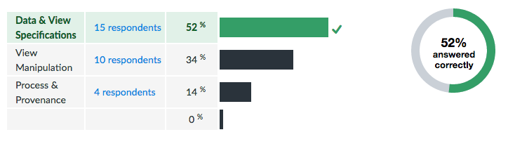

Slide 51
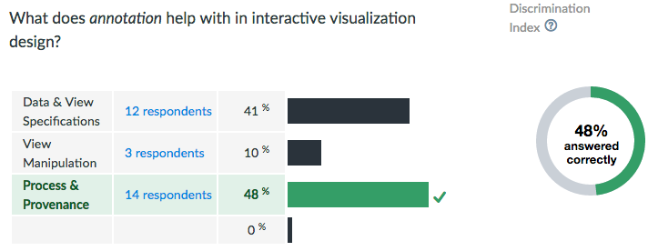

Slide 52
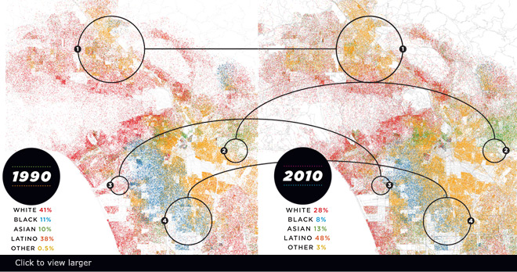
Visualizing Big Data
Make use of every pixel
Notes:
----- Meeting Notes (3/26/15 09:10) -----
storytelling

Slide 53
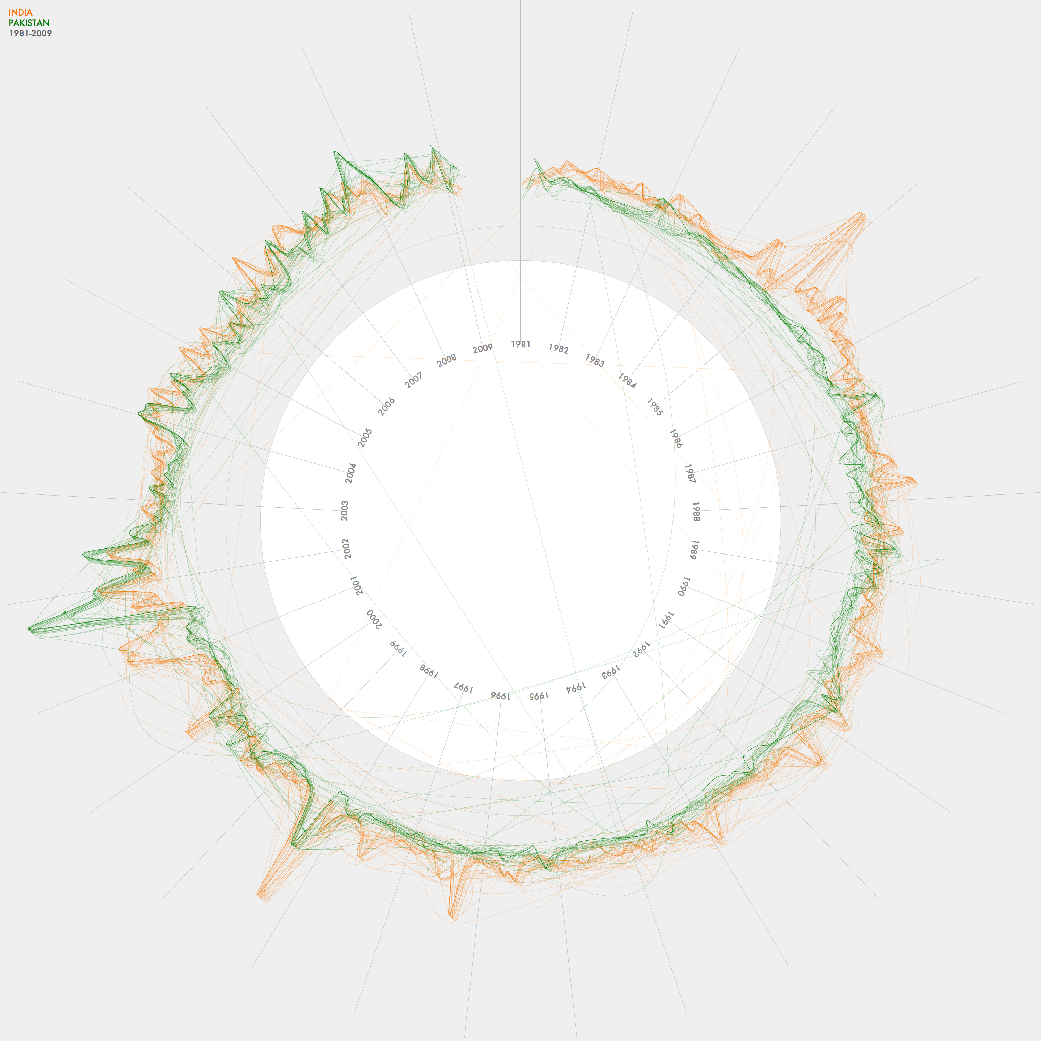
Visualizing Big Data
Make use of every pixel
Use color and location to break the data up and allow the viewer to easily filter

Slide 54
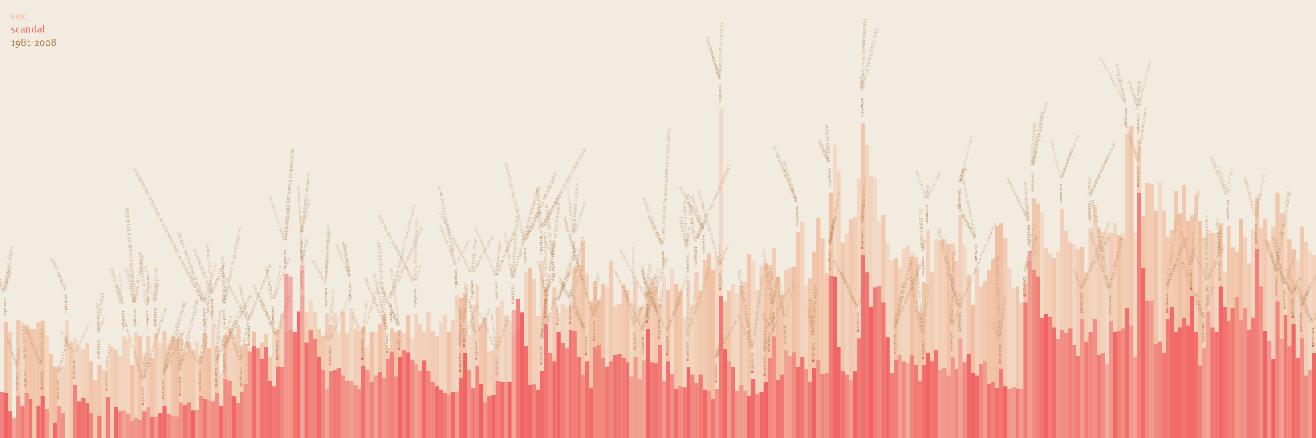
Visualizing Big Data
Make use of every pixel
Use color and location to break the data up and allow the viewer to easily filter
Give a sense of things and use zooming for detail

Slide 55
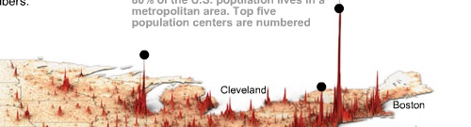
Visualizing Big Data
Make use of every pixel
Use color and location to break the data up and allow the viewer to easily filter
Give a sense of things and use zooming for detail
Add a dimension such as time or height for a key variable

Slide 56
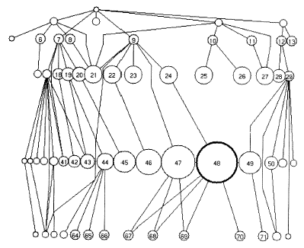
Visualizing Big Data
Make use of every pixel
Use color and location to break the data up and allow the viewer to easily filter
Give a sense of things and use zooming for detail
Add a dimension such as time or height for a key variable
Allow exploration through distortion, filtering, highlighting, and linking

Slide 57
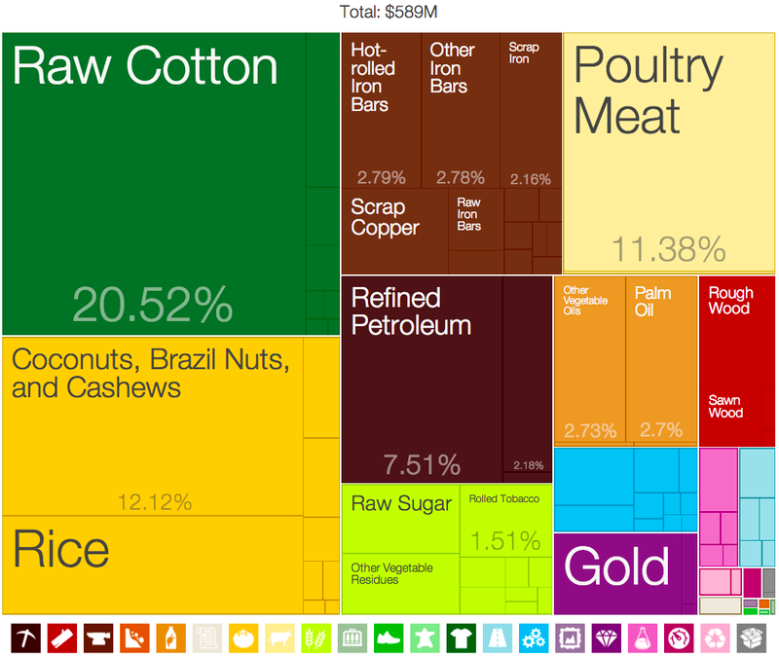
Visualizing Big Data
Make use of every pixel
Use color and location to break the data up and allow the viewer to easily filter
Give a sense of things and use zooming for detail
Add a dimension such as time or height for a key variable
Allow exploration through distortion, filtering, highlighting, and linking
Exploit hierarchy and connectivity

Slide 58
Example case studies we talked about
Mobile data (different types of users)
Location data [Gates building; Byte]

Slide 59
Case Study: Mobile: Big Data of 1
Accelerometer
Applications
Battery
Bluetooth
Calls
Messaging
Gravity
Gyroscope
Light
Linear Accelerometer
Location
Magnetometer
Network Usage
Orientation
Pressure
Processor
Proximity
Rotation
Screen
Telephony
Temperature
Traffic
Wi-Fi
… many more

Slide 60
Why Study Real World Use?
Captures most realistic examples of mobile device usage
Collect large datasets from individuals by collecting data in the background
Usage may change over time

Slide 61
Human Issues in Data Collection
Recruitment
Attrition
Compliance
Untracked devices
What else?

Slide 62
Three false assumptions of mobile
Phones are smart [not so much about context]
Apps are used [usually not; usage is also diverse with 95% of sessions < 60secs]
Notifications lead to use [only 25% of use!]
Phones are on & on people
1/5 of the time phones are off
50% in reach; 47% further away
Adapted from http://www.fordham.edu/economics/Vinod/correl-regr.ppt

Slide 63
Our iterative process
Questions
Data Sets
New Questions
How much users use their phones?
A formative study with 10 participants for 1 month
Are there different user types?
Can we predict when users are interruptible?
How do users interact with their phones?
Can we predict intent?
Can we predict next task?
A field user study with 30 participants for 1 month
How can we streamline mobile device use?
How do users interact with wearables?
Can we model mobile usage routines?

Slide 64
Location Data Sets
 | Augsburg Occupancy | CMU Occupancy | UCSD Movement | CMU Movement
Scope | 4 People, (summer + [break] + fall) | 300 data points per day per room (temp & occupancy) | 275 students, M=11 weeks | 6 People
Total locations | 15 | 293 Rooms | 200 | 2074 (10x10 meter segments)
Days | M=23.25 (SD 3.42) | M=188.65 (SD 4.3) | M=25.56 (SD 20.81) | M=58.1 (SD 32.57)
Data points per person/day | M=316.60 (SD 8.55) | N/A | M=508.46 (SD 739.1) | M=497.65 (SD 273.96)
Locations per person/day | M=6.70 (SD 0.70) | N/A | M=3.45 (SD 2.68) | M=44.97 (SD 10.67)

Slide 65
UCSD Data Set Skew

Slide 66
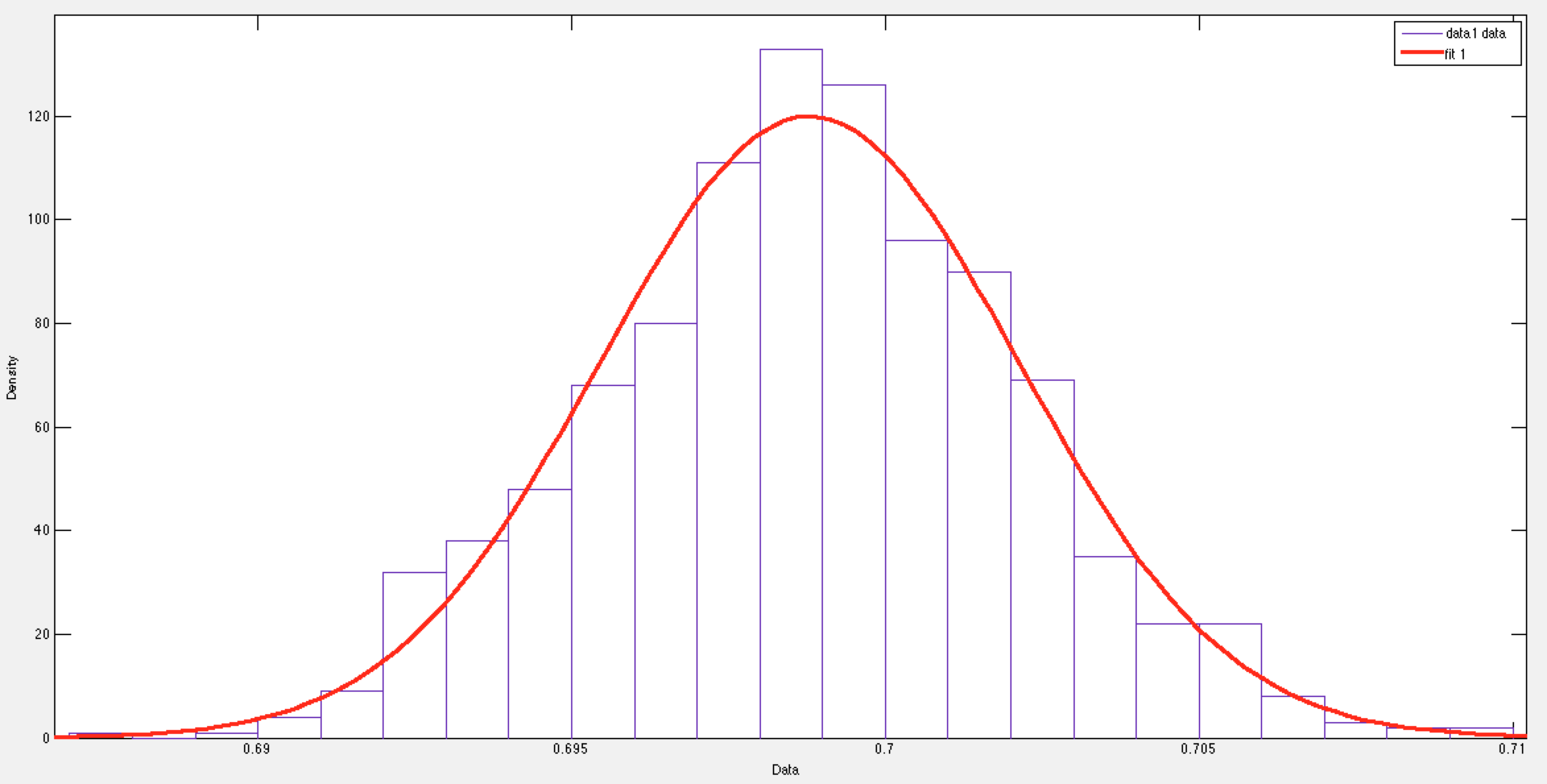
Signal Strength Distribution should be Normal
Signal Strength Distribution for Single Access Point in Gates Hillman Center
Notes:
Indoor location tracking in Gates Hillman Center relied on assumption that signal strength variations of each access point is normally distributed
Analysis of randomly selected Access Points showed normal distribution

Slide 67
Correctness
Define & Identify
Detect & Quantify
Clean & Rectify
Measure & Verify
Notes:
Compared to an alternative algorithm
Original Algorithm: Mean 16.29 m, Std 4.78 m
Alternative Algorithm: Mean: 5.58 m Std 3.50 m

Slide 68
Summary of Techniques Discussed
How to detect and quantify errors?
Glitch signature
Summary statistics
Graphs and Charts
Specific things to look for
Outlier detection techniques
Skew
Techniques for fixing
Imputation
Winsorization
Domain specific approaches
Define & Identify
Detect & Quantify
Clean & Rectify
Measure & Verify

